Slide 1
Behavioural Design Pattern
Ritik Saxena
Shubham Bhamare

Slide 2

Design Patterns:-
Design Patterns can be defined as the ways given by the experienced developers in order to make the system design , development and representation more easy and clearer. There are three major types of Design Patterns:-
Creational Design Pattern
Structural Design Pattern
Behavioural Design Pattern

Slide 3
What are Behavioural Design Pattern .??
Behavioural design pattern are always concerned with the interaction and communication between different objects. These design patterns address the issues related to the object interaction, event handling and managing the object behaviour.
Example:- Observer, Strategy, Command, State Design

Slide 4
Advantages of Behavioural Design Patterns :- Behavioural Design patterns provides the developers various advantages such as – i) Better Flexibility ii) Enhanced Testability iii) Easy to Extend iv) Organized code

Slide 5
Better Flexibility :- These pattern allows the interaction between objects at run time and changes in the behavior of the object without affecting the overall system.
Enhanced Testability :- As there are clear responsibilities of each object, it is always easy to write unit tests for each component and ensure their proper functioning.

Slide 6
Easy to Extend :- By using behavioral design pattern, new behaviors can be added by introducing the new classes or by modifying the existing ones without impact the entire project or system.
Organized code :- These patterns helps in organizing code by clearly defining the responsibilities which leads to better modularity and maintainability of the code as well.

Slide 7
Observer Design Pattern :-
The observer design pattern defines one to many dependencies between objects so that if one object changes its state all its dependent are notified and update automatically . It allows loose coupling between objects by allowing them to communicate without having explicit knowledge of each other.

Slide 8
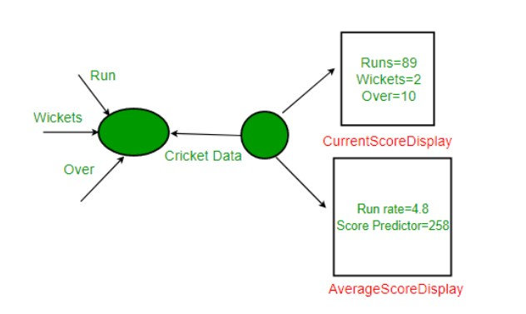
Here is an Example-

Slide 9
Real life Applications :-
Observer Pattern – observer pattern can be used in various real life Problems. Some of them are - i) Social Media Platforms ii) Stock Market Monitoring iii) Event driven Systems iv) Weather Monitoring Systems

Slide 10
Strategy Design Pattern:-
Strategy pattern is used when we have multiple algorithm for a specific task & client decides the actual implementation to be used at runtime.
The Strategy pattern attempts to solve the issue where you need to provide multiple solutions for the same problem so that one can be selected at runtime.
Task
Solution A
Solution B
Solution C

Slide 11
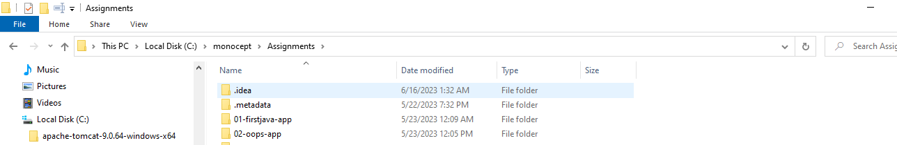
Strategy-Real Time Example:-
Compress
firstjava-app.zip
Firstjava-app.rar

Slide 12
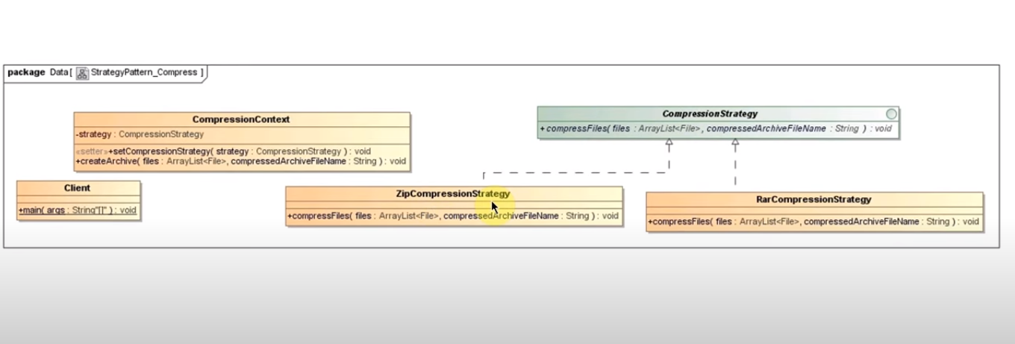
Strategy- Implementation

Slide 13

State Design Pattern:-
The State Pattern allows an object to alter its behavior when its internal state changes.
The State pattern is a design pattern that allows an object to completely change its behavior depending upon its current internal states.
Operation A
Context
Request
or
State A
State B
Operation B

Slide 14
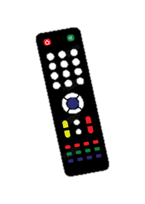

State-Real Time Example:-
Context
State=On/Off

Slide 15
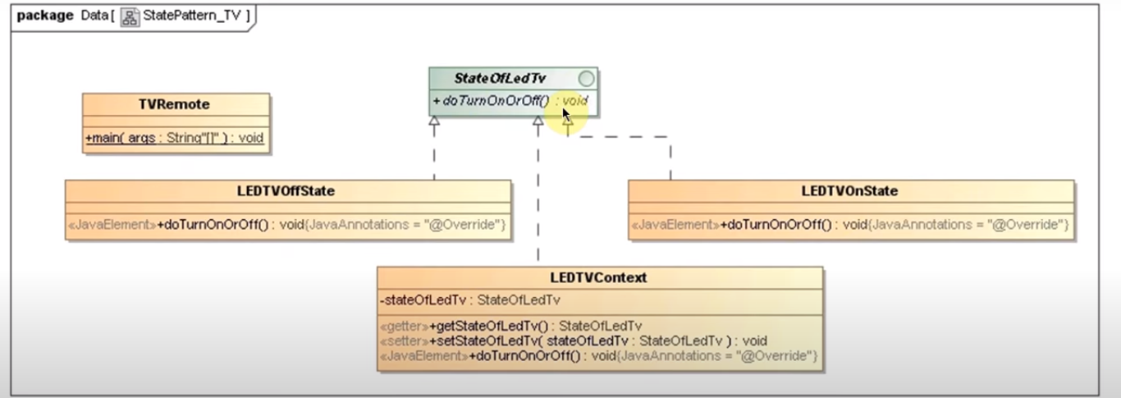
State-Implementation:-

Slide 16
Thank You

